Slide 1
Topic of presentation is
Supercomputer and Mainframe Computer
Presented By BP Bhatta
Masters of Science In Computer Science

Slide 2
Super Computer
A supercomputer is a high-performance computing system designed to perform exceptionally complex and computation-intensive tasks.
Supercomputers are defined by their ability to execute trillions (or even quadrillions) of operations per second.
Unlike regular computers, supercomputers achieve their performance through parallel processing, advanced architectures, and optimized hardware and software designed for maximum efficiency.

Slide 3
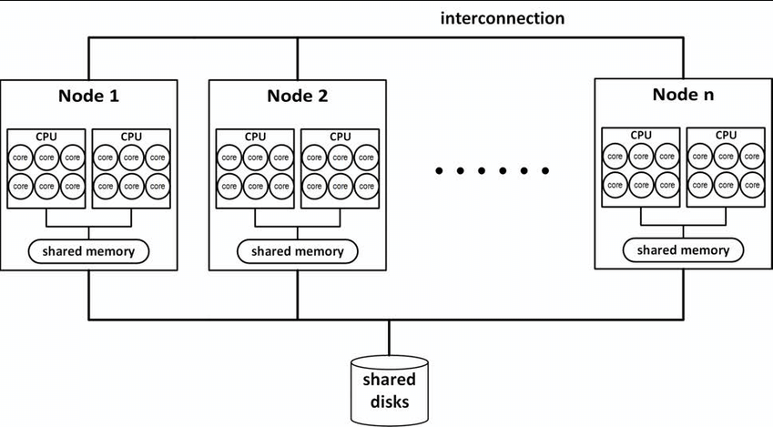

Slide 4
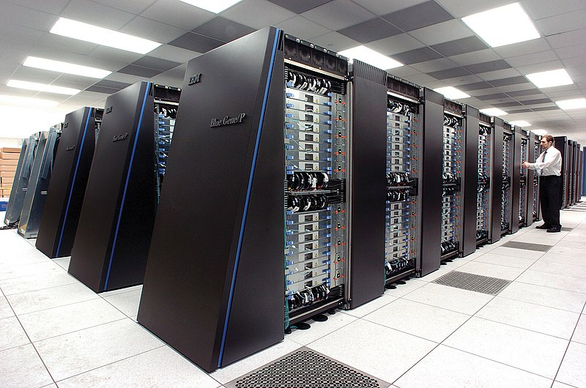
Characteristics of Supercomputers
Unparalleled Speed:
Massive Parallelism:
High Memory Capacity:
Custom Architectures:
Energy Consumption and Cooling

Slide 5
Applications of Supercomputers
Scientific Research
Climate and Weather Forecasting
Engineering Simulations
Artificial Intelligence and Machine Learning
Defense and National Security
Medical Research

Slide 6
Examples of Supercomputers
El Capitan(USA): Speed: 2.746 Exaflops (National Security and Scientific Research)
Fugaku (Japan): Speed: 442 Petaflops , Climate modelling, AI Research
Summit (USA): Speed:148 Petaflops, Physics simulation, AI Research
KUSC(Nepal): Featuring 184 servers, used for Helathcare, education and Research.

Slide 7
Mainframe Computer
A mainframe computer is a large, powerful computing system designed to process and manage massive volumes of data, handle numerous simultaneous transactions, and support hundreds or thousands of users concurrently. These computers are essential for large organizations requiring high reliability, scalability, and security.

Slide 8
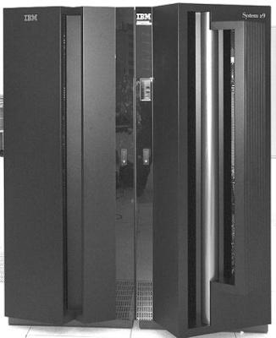
Characteristics of Mainframe Computers
High Processing Power
Scalability
Multi-user Support
Reliability and Availability
Robust Security
Centralized Processing

Slide 9
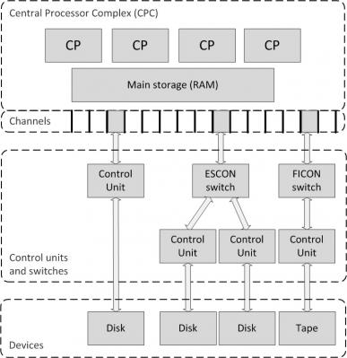
ESCON: Enterprise Systems Connection
FICON:
Fiber Connection

Slide 10
Applications of Mainframe Computers
Banking and Finance:
Government:
Retail:
Healthcare:
Telecommunications:

Slide 11
Examples:
IBM Z Series (IBM z15, z16)
Unisys ClearPath Series
Hitachi Virtual Enterprise (V Series)
IBM 1401, purchased in 1971 in Nepal (2028 BS).
ICL 2950/10, bought in 1981 in Nepal (2038 BS)

Slide 12
Difference between Supercomputer and Mainframe computer
Supercomputer | Mainframe Computer
Supercomputers are used for large and complex mathematical computations. | Mainframe computers are used as a storage for large databases and serve as a maximum number of users simultaneously.
Supercomputer’s speed is more than Mainframe computer. It can execute billions of instructions within a second. | Mainframe computer’s speed is comparatively less than Supercomputers. In these millions of instructions are executed simultaneously.
Supercomputers are the largest computers. | Mainframe computers are smaller than supercomputers in size.
Supercomputers are the costliest in the world. | Mainframe computers are less costly than supercomputers.

Slide 13
Super computers are mostly purpose-built for one or a few specific institutional tasks. | Mainframe computers are built to handle a large variety of tasks.
Seymour Cray invents the Supercomputer. | The first successful mainframe computer is invented by IBM.
Supercomputers can have a processing speed in the range of 100 to 900 MIPS. | Whereas Mainframe computers can have a processing speed in the range of 3-4 MIPS to as high as 100 MIPS.
Supercomputers find their application in fields like nuclear weapon simulation, etc. | Mainframe computers find their application in fields such as finance, health, etc.

Slide 14
Thank you
Any Queries?

